Slide 1
Computer Number Systems
1-1, 1-2, 1-3
- Binary
- Decimal
- Octal
- Hexadecimal
Copyright © 2020 Legion of Learners. All Rights Reserved.
www.lol-101.com

Slide 2
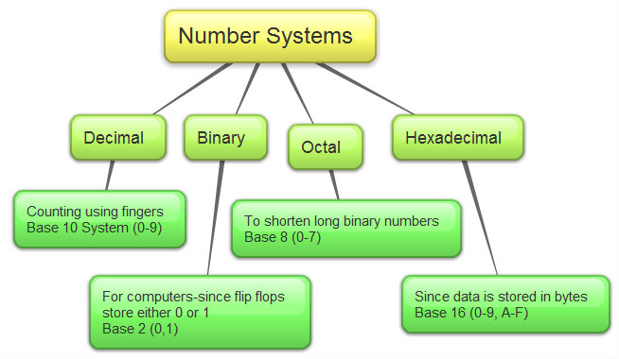
What are Computer Number Systems?
Special numeric systems used by computers
Based on different amount/type of numbers
Helps store data/numbers
Copyright © 2020 Legion of Learners. All Rights Reserved.
www.lol-101.com

Slide 3
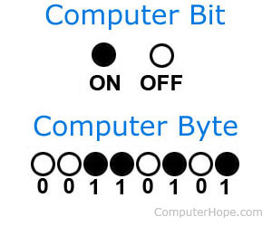
Why do we use computer number systems?
Base 2 numbers (binary) are used because computers are made up of transistors (ON/OFF)
Base 8 numbers (octal) became more popular because each base 8 number was able to store 1 byte
Base 16 numbers (hexadecimal) are not used in computers, but easy to work with
Copyright © 2020 Legion of Learners. All Rights Reserved.
www.lol-101.com

Slide 4
1-1 What are base 2 numbers, and why do we need them?
Base 2 numbers are known as the Binary Number System
One of the main computer number systems
Called base 2 numbers, because binary is based off of 2 numbers, 0 and 1 only
Many computers/computing systems, especially the earlier models, use binary
Computer uses thousands of transistors to store data
Transistor is like a switch, it only can be ON/OFF, hence why binary is only 0 or 1
Copyright © 2020 Legion of Learners. All Rights Reserved.
www.lol-101.com

Slide 5
1-2 How do you convert base 10 numbers to base 2, 8, 16?
Divide the decimal number by the base #, and write down the remainder
Continue dividing the same decimal number until the decimal number is 0
All the digits of the remainder will form the specific number you are looking for
Copyright © 2020 Legion of Learners. All Rights Reserved.
www.lol-101.com

Slide 6
Convert Decimal → Binary (base 2)
Divide the decimal number by 2, and write down the remainder each time. Every digit of the remainder will form your binary number!
Example- Decimal: 11 → Binary: ???
The answer is the remainder digits
from bottom to top, written in one number
Answer:
Decimal: 11 → Binary: 1011
Digits of Binary: 0 1
Division | Answer | Remainder
11/2 = | 5 | 1
5/2= | 2 | 1
2/2= | 1 | 0
1/2= | 0 | 1
Copyright © 2020 Legion of Learners. All Rights Reserved.
www.lol-101.com

Slide 7
Convert Decimal → Octal (base 8)
Divide the decimal number by 8, and write down the remainder each time. Every digit of the remainder will form your octal number!
Example- Decimal: 121 → Octal: ???
The answer is the remainder digits
from bottom to top, written in one number
Answer:
Decimal: 121 → Octal: 171
Digits of Octal: 0 1 2 3 4 5 6 7
Division | Answer | Remainder
121/8= | 15 | 1
15/8 | 1 | 7
1/8 | 0 | 1
Copyright © 2020 Legion of Learners. All Rights Reserved.
www.lol-101.com

Slide 8
Convert Decimal → Hexadecimal (base 16)
Divide the decimal number by 16, and write down the remainder each time. Every digit of the remainder will form your hexadecimal number!
Example- Decimal: 1207 → Hexadecimal: ???
The answer is the remainder digits
from bottom to top, written in one number
Answer:
Decimal: 1207 → Hexadecimal: 4A4
Digits of Hexadecimal: 0 1 2 3 4 5 6 7 8 9 A B C D E F
Division | Answer | Remainder
1207/16= | 75 | 7
75/16= | 4 | 11 → A
4/16 | 0 | 4
Copyright © 2020 Legion of Learners. All Rights Reserved.
www.lol-101.com

Slide 9
1-3 How do you convert base 2, 8, 16 numbers to base 10 numbers?
Instead of dividing, now you will multiply
Each digit of any computer number system represents a certain amount, based on their base #
For example, in hexadecimal, if you see the number B, you know it represents 12 in decimal
Add up each digit based on the amount it represents
Example: What does the decimal number 25 represent?
The rightmost digit represents only 1s, or (10^0)
The second digit represents 10s, or (10^1)
Copyright © 2020 Legion of Learners. All Rights Reserved.
www.lol-101.com

Slide 10
Convert Binary → Decimal
Since Binary is base 2, we know that each digit represents an amount based on 2^(x)
The first digit (rightmost) represents 2^0, the second digit represents 2^1, the third represents 2^2, etc…
Binary: 11010 → Decimal: ???
0*(2^0) + 1*(2^1) + 0*(2^2) + 1*(2^3) + 1*(2^4) = 0+2+0+8+16 = Decimal: 26
2^0 because it is the 1st digit, 2^1 because 2nd digit, 2^2 because 3rd digit, etc...
You could think of it as (Base#)^(digit# - 1)
Copyright © 2020 Legion of Learners. All Rights Reserved.
www.lol-101.com

Slide 11
Convert Octal → Decimal
Since Octal is base 8, we know that each digit represents an amount based on 8^(x)
The first digit (rightmost) represents 8^0, the second digit represents 8^1, the third represents 8^2, etc…
Octal: 357 → Decimal: ???
7*(8^0) + 5*(8^1) + 3*(8^2) = 7+40+192 = Decimal: 239
Copyright © 2020 Legion of Learners. All Rights Reserved.
www.lol-101.com

Slide 12
Convert Hexadecimal → Decimal
Since Octal is base 16, we know that each digit represents an amount based on 16^(x)
The first digit (rightmost) represents 16^0, the second digit represents 16^1, the third represents 16^2, etc…
Hexadecimal: FB9 → Decimal: ???
(F=15, B=11)
9*(16^0) + 11*(16^1) + 15*(16^2) = 9+176+3840= Decimal: 4025
Copyright © 2020 Legion of Learners. All Rights Reserved.
www.lol-101.com

Slide 13
Kahoot!
https://create.kahoot.it/share/6dcfe796-7e01-4b9f-9947-41b9f5045fa0
Copyright © 2020 Legion of Learners. All Rights Reserved.
www.lol-101.com

